Slide 1







FoodSaver
By Team 3
CS 160-01

Slide 2


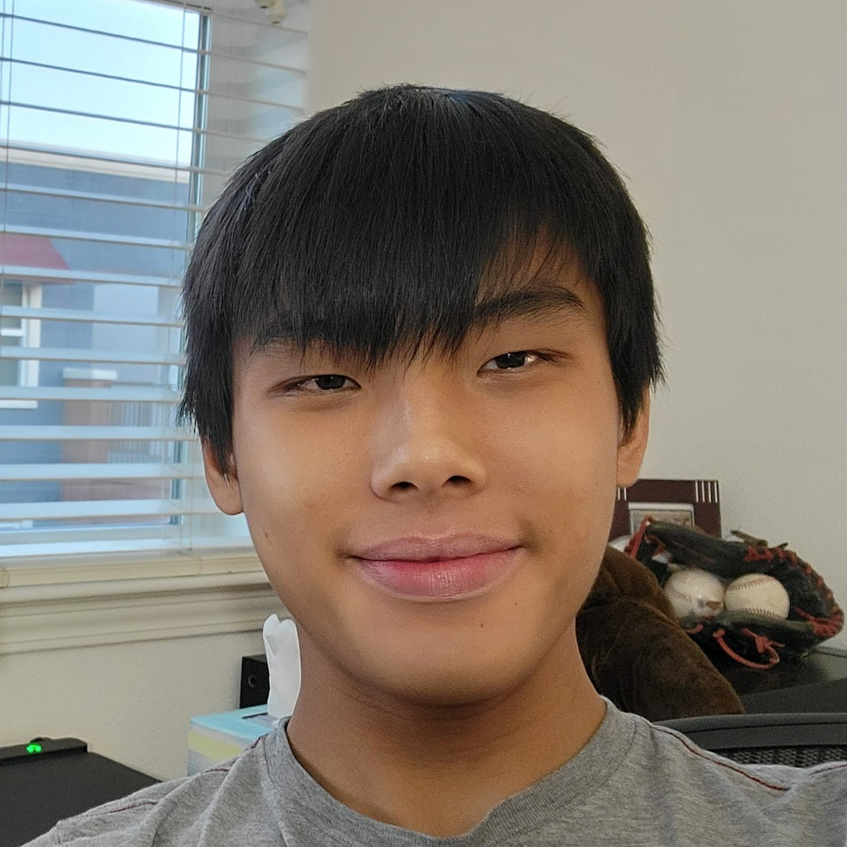

Our Team
Chase Barman
Alvin Lee
Schuyler Ng
Robin Goswami
Backend
Spring Boot
MongoDB
Cloud + Security
Linode VPS
HTTPS (TLS)
Frontend
React Native
Inventory
Meal Planning
Frontend
React Native
Recipe Creation
Recipe Suggestion
Frontend
React Native
Barcode Scanner
Expiry

Slide 3
Our Vision
For the eco-conscious consumer who wants to reduce their food waste and carbon footprint,
FoodSaver is a mobile application that provides shopping assistance, kitchen inventory management, recipe management and suggestions, and meal planning features that streamline food preparation and help users incorporate all of the ingredients that they buy into their cooking.
Unlike similar applications, FoodSaver assists the user throughout the entire food preparation process, from grocery shopping to meal planning to cooking, with features that make meal preparation simpler and more convenient than our competitors.

Slide 4
Why is Food Waste Important?
40%
22%
10%
USA
Households
Big Picture
30-40% of food is wasted each year in the US (USDA).
22% of food waste happens at the consumer level (FAO, UN).
8-10% of Greenhouse Gas emissions result from food waste (FAO, UN).

Slide 5
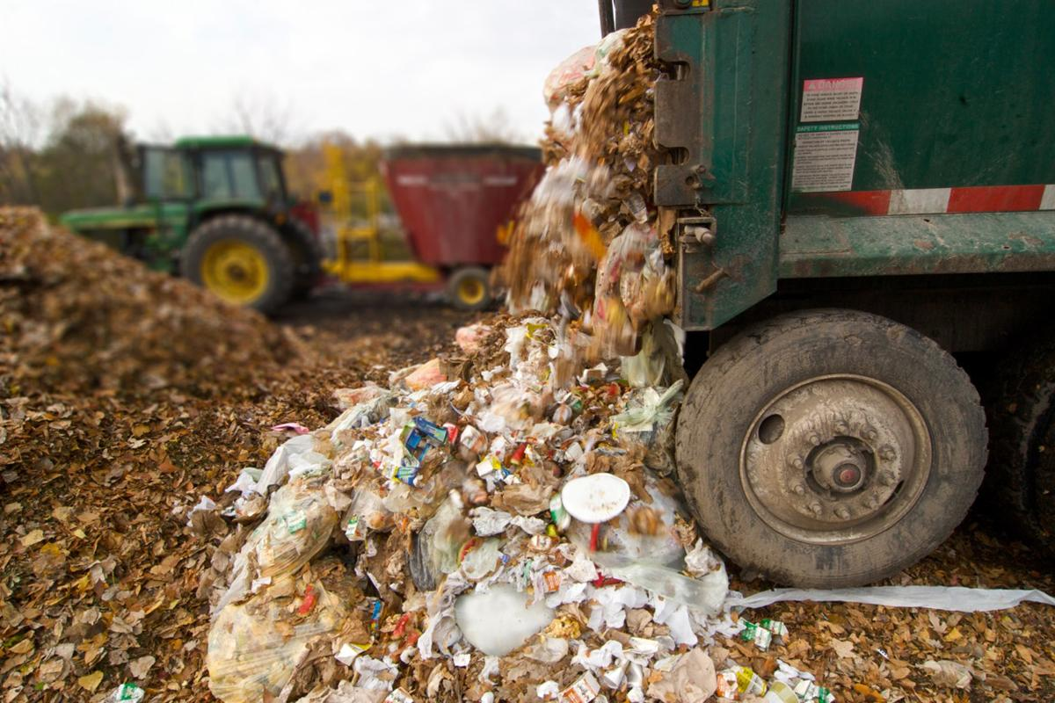
Consumer food waste causes 37% of food waste GHG emissions.

Slide 6
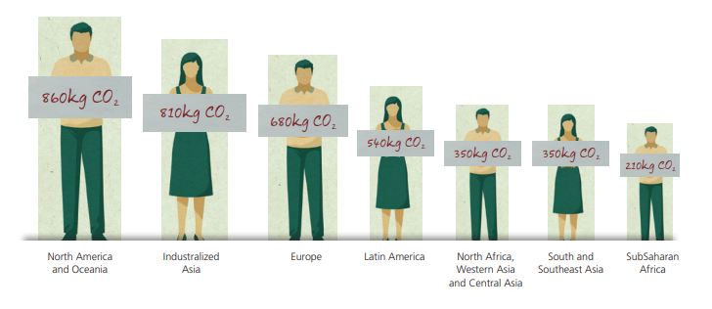
Americans have the highest per-capita GHG emissions from food wastage (Food and Agriculture Organization, UN).

Slide 7
Features & Goal
Features
Kitchen Inventory - maintain a catalog of current and past items in your kitchen
Barcode Scanner - use a camera to scan groceries into your kitchen inventory and see its nutrition grade
Expiry - view food items that are nearing expiration or that expired in the past
Recipe Management - save and edit recipes stored in the application
Recipe Suggestion - use AI to find new ways of incorporating on-hand food items into your cooking
Meal Plan Management - plan meals ahead of time with a calendar-based recipe system
Our goal is to help users incorporate all of the food items in their kitchen into their meals, before they expire and become harmful food waste.

Slide 8
Demo

Slide 9






Q&A

Slide 10

Thanks!
Interested in FoodSaver?
https://github.com/Bright3r/FoodSaver

Slide 11
Works Cited
Food and Agriculture Organization of the United Nations. (n.d.). FAO Knowledge Repository. https://openknowledge.fao.org/server/api/core/bitstreams/7fffcaf9-91b2-4b7b-bceb-3712c8cb34e6/content
Richard, C. (2018, December 19). Already a Climate Change Leader, California Takes on Food Waste. Civil Eats. https://civileats.com/2018/12/10/already-a-climate-change-leader-california-takes-on-food-waste/
United States Department of Agriculture. (2025, May 13). Food Waste and its Links to Greenhouse Gases and Climate Change. Home. https://www.usda.gov/about-usda/news/blog/food-waste-and-its-links-greenhouse-gases-and-climate-change

